Slide 1
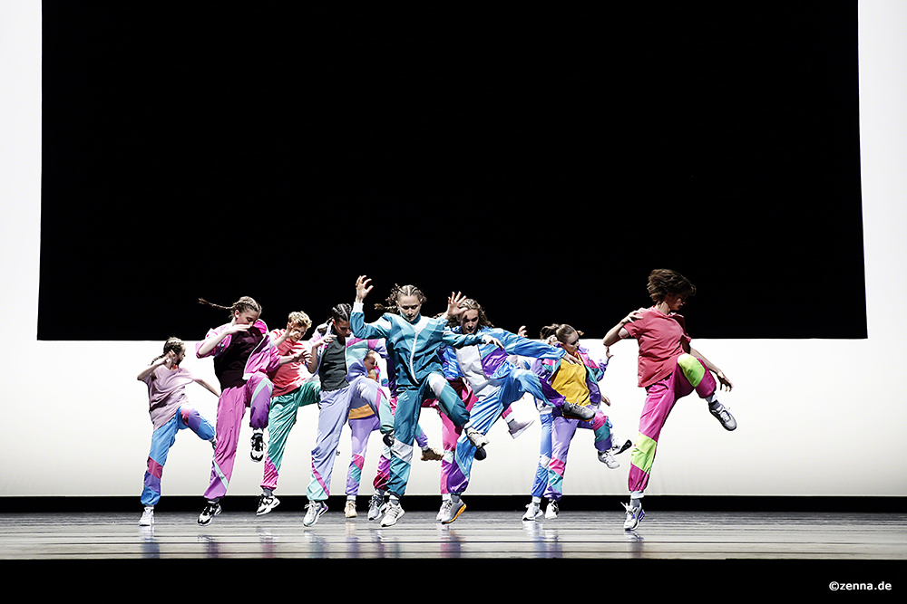
BA Dance Programme
Prof. Juliana Sabino Wilhelm | Head of Programme

Slide 2
BA Dance Programme
Bachelor of Arts // 3-Year Programme // Study programme in English
Audience
Young dancers aged 16 and above: Applicants should have prior dance experience and a strong foundation in various dance techniques.
Individuals with a deep interest in dance: Those who are committed to developing their skills not only in classical ballet, contemporary dance, and improvisation
Future dance professionals: Students who aspire to become professionals in this field, with a well-rounded theoretical knowledge, a committed and open minded approach and wanting to develop their own artistic voice.
International applicants: The programme welcomes students from around the world, fostering a diverse and inclusive learning environment.

Slide 3
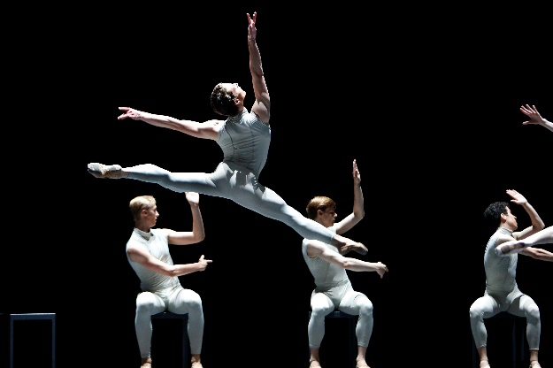
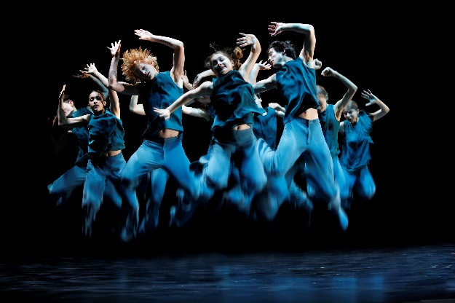
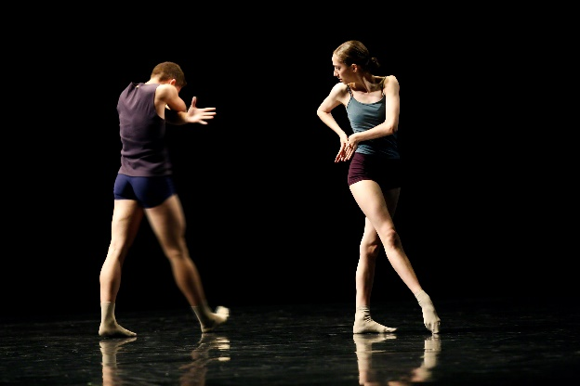
BA Dance Programme
Programme Characteristics
The BA Dance Programme at the Palucca University of Dance Dresden offers a comprehensive curriculum designed to develop both the technical and artistic skills of aspiring dancers. The key contents of the programme include:
Dance Techniques and Styles
Classical Ballet: Emphasis on traditional ballet techniques and neoclassical repertoire with a international team of teachers. Also classes like Pas de Deux and Variations are part of the curriculum in all years.
Contemporary Dance: Exploration of modern-contemporary dance styles and innovative movement research with varied techniques.Also classes in partnering and repertoires are part of the curriculum in all years.
Improvisation: Developing creativity, possibilities and spontaneity in dance. Also compositon as a practical class is part of the curriculum.

Slide 4
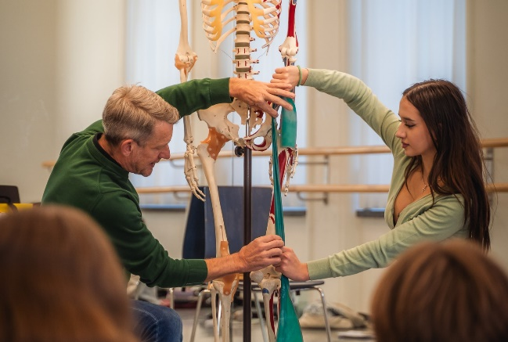

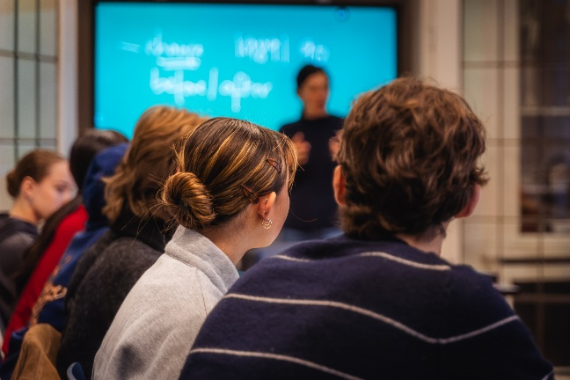
BA Dance Programme
Theoretical and Practical Courses
Anatomy: Understanding the human body and its mechanics in relation to dance.
Dance History: Studying the evolution of dance and its cultural significance.
Music Theory: Learning the fundamentals of music to enhance dance performance.
Dance Analysis: Building different perspectives for deeper understanding of the artform.
Dramaturgie: Looking at different ways of construction and concepts in Choreographic works
Dance and Media: Understanding dance not only as live artform, but how it can be portrait with video and images
Stage production: Learning about stage lights and sets, music rights and all that belongs to dance performances
Stage management: Learning about dancers rights, contracts and regulations in the field

Slide 5
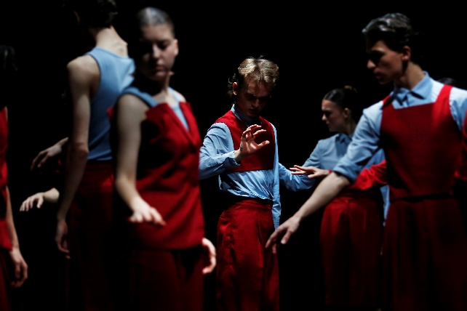
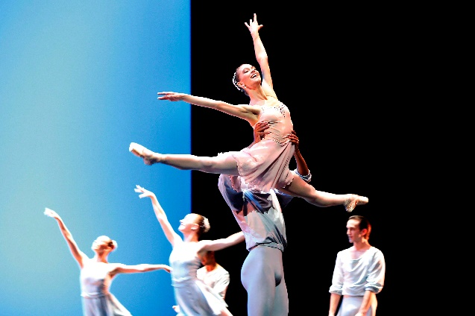
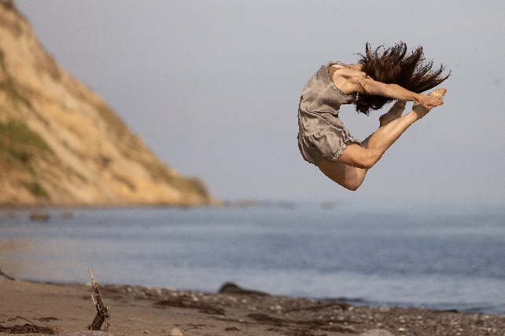
BA Dance Programme
Performance Opportunities
Stage Performances: Regular opportunities to perform and gain experience in front of an audience on different stages and settings.
Workshops and Masterclasses: Sessions with guest artists and industry professionals.

Slide 6
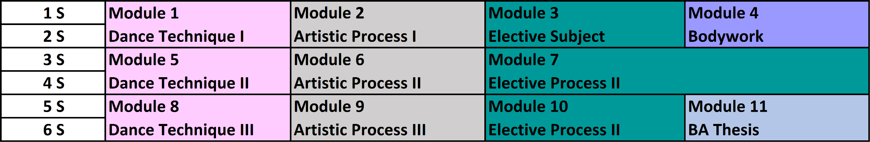

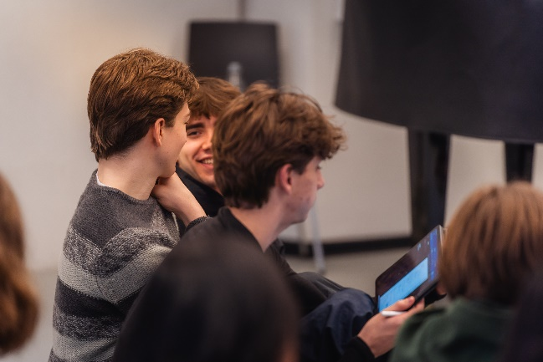
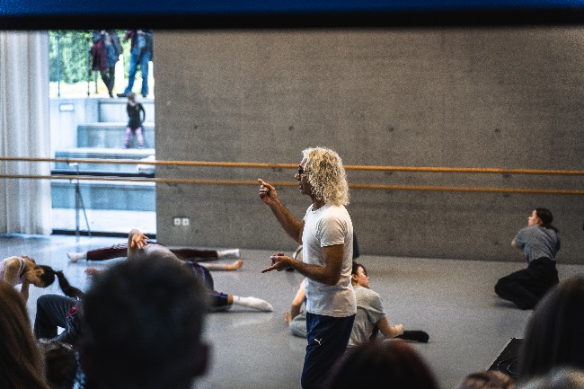
COURSE OF STUDY/MODULES

Slide 7
PREREQUISITES
Physical aptitude
Fantasy of movement and ability to express oneself through dance
Musicality
Dance background in the subjects of ballet, contemporary dance and improvisation at the level required for the BA Dance Programme
Admissions to the BA Dance Programme, according to Sec. 18 (1) (2) (12) SächsHSG, requires that the applicant has earned a school-leaving certificate from a secondary or senior secondary school or has an entrance qualification recognised to be equivalent to such and a particular artistic aptitude.
© Christine Anna Schulze Beiering
© Matthias Rietschel
© Christine Anna Schulze Beiering
© Fernando Coelho

Slide 8

HOW TO APPLY (BAT)
Online Application (next enrolment BAT: Winter Semester 2025/26)
Application period 2025:
planned from 01.01.-28.02.25
Proof of at least B1 English level must be submitted by the enrolment date at the latest
Fees and Tuition
Application fee: EUR 50 (one-time fee)
Semester fee: EUR 309.30 each semester (may still be subject to change)
→ fee includes student community & student service, public transport
international students applying for a German student visa (non EU-Students) may need to show proof of financial resources of at least 11,904 euros for the first year, with a maximum withdrawal amount of 992 euros per month

Slide 9
APPLICATION DOCUMENTS
Before the applicant’s self-registration in the application portal, the following documents must exist digitally so that they can then be uploaded in the application portal.
A tabular resume (CV) with precise information regarding your previous education (in PDF format)
One passport photo (JPG format)
Two to three dance photos (JPG format)
Proof of having paid the application fee of 50.00 EUR (receipt in PDF format, Bank details under application fees)
If appropriate, evidence concerning your study periods to date as well as results of your studies or tests (in PDF format)
Please take the following into consideration when providing video links over the application portal:
The application videos need to be uploaded to an appropriate platform, such as, e.g., YouTube or Vimeo
The application videos should present skills in modern/contemporary dance, classical dance and improvisation. Please submit four individual video links through the portal (the exact content of the videos can be found on our website.)

Slide 10
APPLICATION DOCUMENTS
The following documents are to be submitted by the enrolment date at the latest:
Language certificate proving an English level B1 (The following language certificates are recognised: Cambridge Certificate: Preliminary English Test (PET), TOEFL (iBT), IELTS, UNICERT (not applicable for native English-speaking applicants).
Submission of a doctor’s certificate certifying the particular endurance in regard to admission to a dance study programme as preparation for a professional career
Certified copy of the most recent general educational school-leaving certificate
Proof of health insurance
Proof of payment of the semester tuition

Slide 11
ADMISSION AND ENROLLMENT
Enrollment is preceded by an admissions procedure. This consists of an online video aptitude test and an on-site entrance exam. After passing the online video aptitude test, the entrance exam takes place on site in Dresden.
Application steps:
Registration in the application portal
input of personal data
Upload all required documents, video links and photos (see also online application)
Applications will only be considered if all required documents and videos have been submitted in full by February 28, 2025 at the latest.
The result of the online video aptitude test will be communicated to the applicants via the application portal by March 22nd, 2025 at the latest.
Only after passing the online video aptitude test there will be an entrance exam, which will take place from May 2nd to 4th, 2025 in Dresden. The result of the entrance exam will be communicated after the exam. If you fail the exam, you can access the notification of exclusion with the reason via the application portal no later than six weeks after the entrance exam.

Slide 12
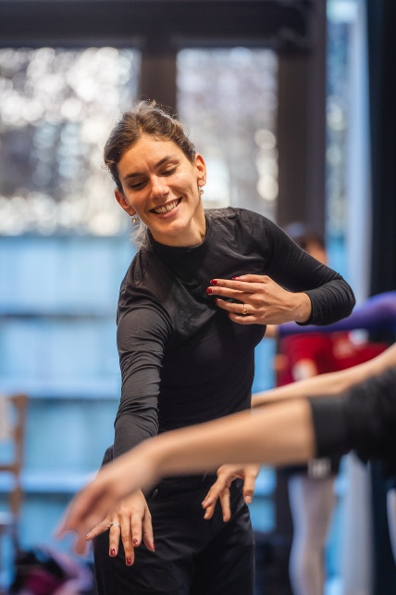

STAY IN TOUCH!
Vice-Rector for Academic Affairs /
Head of BA Dance Programme
Prof. Juliana Sabino Wilhelm
j.sabino@palucca.eu
© Ida Zenna
Homepage
https://palucca.eu/en/study-programmes/dance/ba-dance-programme
Notes:
72 hours before the set deadline of handing in the completed tasks, the candidate will receive all the tasks, 6 music files, a short dance video and the theme for the written reflection.

Slide 13
© Ida Zenna

